Slide 1

Innopolis University
Control Theory (Linear Control)
Lecture 3
Transfer Functions
Sergei Savin, PhD
Slides design by Marko Pezer & Artem Bakhanov

Slide 2
Topic of the Lecture
Transfer Functions
From State Space Model to Transfer Function
Stability and Asymptotic Stability
Solution for an ODE
Control Theory (Linear Control)
Slide 2

Slide 3

Transfer Functions
The relationship between the input $X(t)$ and the output $Y(t)$ for an analog signal system is called a transfer function $Y(t)=F[X(t)]$.
Control Theory (Linear Control)
Slide 3

Slide 4

Transfer Function Representation (1/2)
Consider the following ODE:
$$3\ddot{x}+56\dot{x}−7x=u ⇔ 3\frac{d^{2}}{dt^{2}}x+56\frac{d}{dt}x−7x=u$$
We can introduce differentiation operator $p=\frac{d}{dt}$:
$$3p^{2}x+56px−7x=u$$
Control Theory (Linear Control)
Slide 4

Slide 5
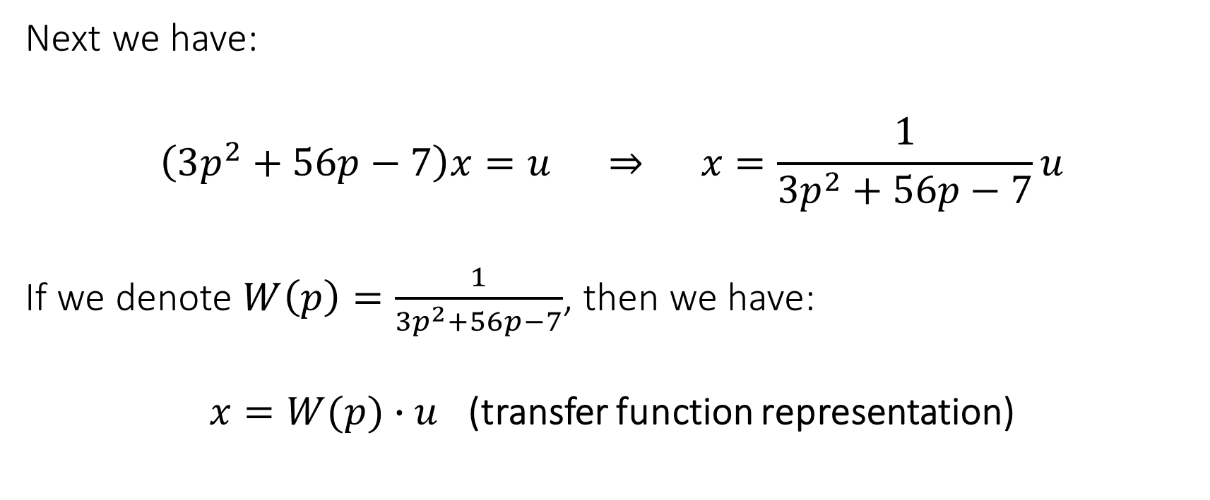
Transfer Function Representation (2/2)
Next we have:
$$\left(3p^{2}+56p−7\right)x=u ⇒ x=\frac{1}{3p^{2}+56p−7}u$$
If we denote $W\left(p\right)=\frac{1}{3p^{2}+56p−7}$, then we have:
$x=W(p)∙u$ (transfer function representation)
Control Theory (Linear Control)
Slide 5

Slide 6

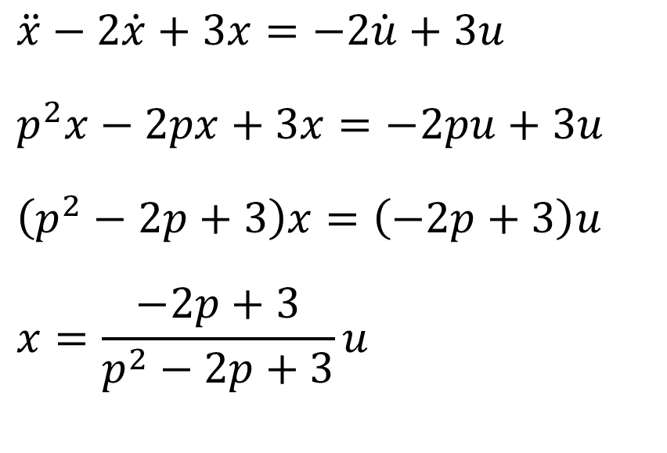
Another Example
$$\ddot{x}−2\dot{x}+3x=−2\dot{u}+3u$$
$$p^{2}x−2px+3x=−2pu+3u$$
$$\left(p^{2}−2p+3\right)x=\left(−2p+3\right)u$$
$$x=\frac{−2p+3}{p^{2}−2p+3}u$$
Transfer function:
$$W\left(p\right)=\frac{−2p+3}{p^{2}−2p+3}$$
Control Theory (Linear Control)

Slide 7
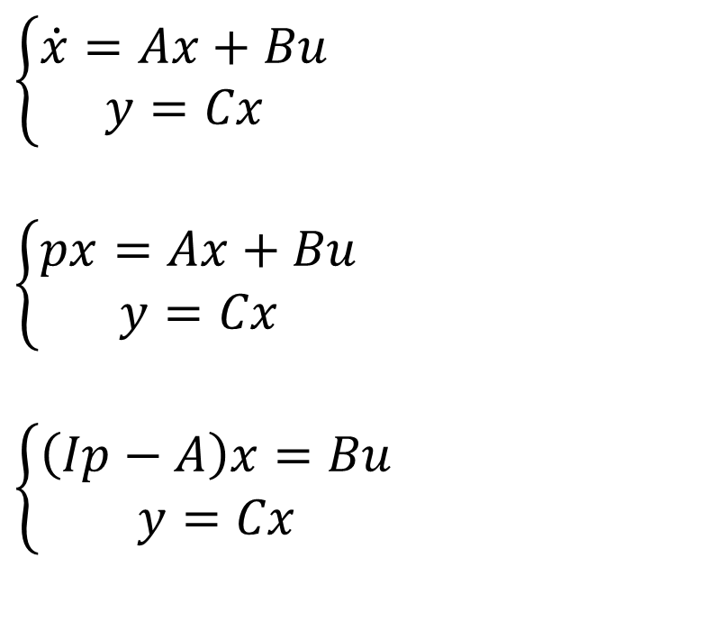
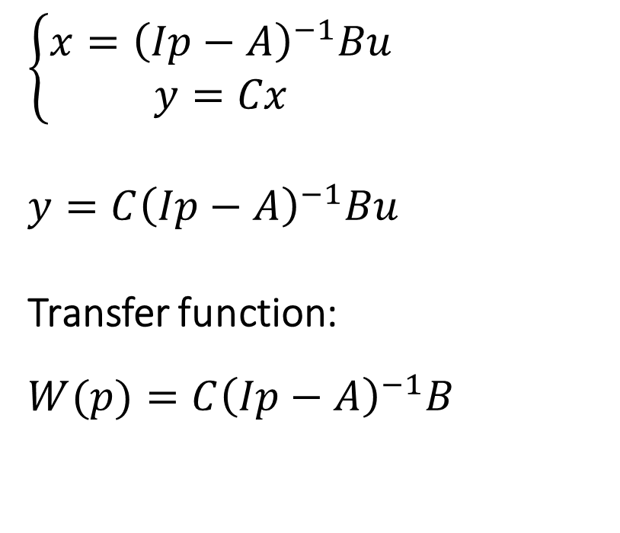
From State Space Model to Transfer Function
$$\left\{\begin{aligned}\dot{x}=Ax+Bu \\ y=Cx\end{aligned}\right.$$
$$\left\{\begin{aligned}px=Ax+Bu \\ y=Cx\end{aligned}\right.$$
$$\left\{\begin{aligned}\left(Ip−A\right)x=Bu \\ y=Cx\end{aligned}\right.$$
$$\left\{\begin{aligned}x={\left(Ip−A\right)}^{−1}Bu \\ y=Cx\end{aligned}\right.$$
$$y=C{\left(Ip−A\right)}^{−1}Bu$$
Transfer function:
$$W(p)=C{\left(Ip−A\right)}^{−1}B$$
Control Theory (Linear Control)
Slide 7

Slide 8

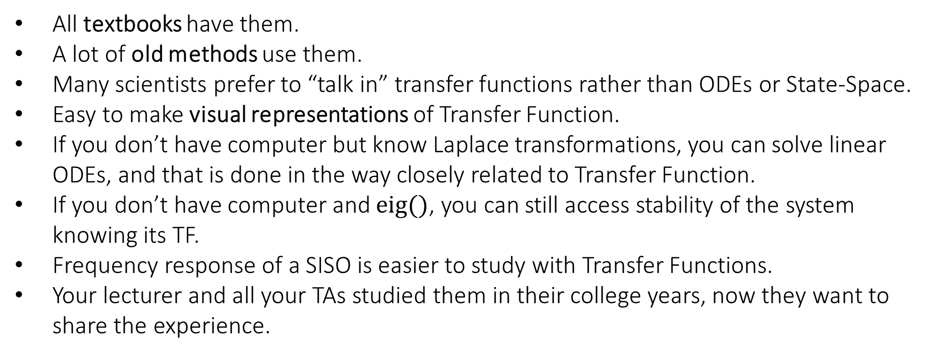
Why Do We Need to Know Transfer Functions?
All textbooks have them.
A lot of old methods use them.
Many scientists prefer to “talk in” transfer functions rather than ODEs or State-Space.
Easy to make visual representations of Transfer Function.
If you don’t have computer but know Laplace transformations, you can solve linear ODEs, and that is done in the way closely related to Transfer Function.
If you don’t have computer and $eig()$, you can still access stability of the system knowing its TF.
Frequency response of a SISO is easier to study with Transfer Functions.
Your lecturer and all your TAs studied them in their college years, now they want to share the experience.
Control Theory (Linear Control)
Slide 8

Slide 9
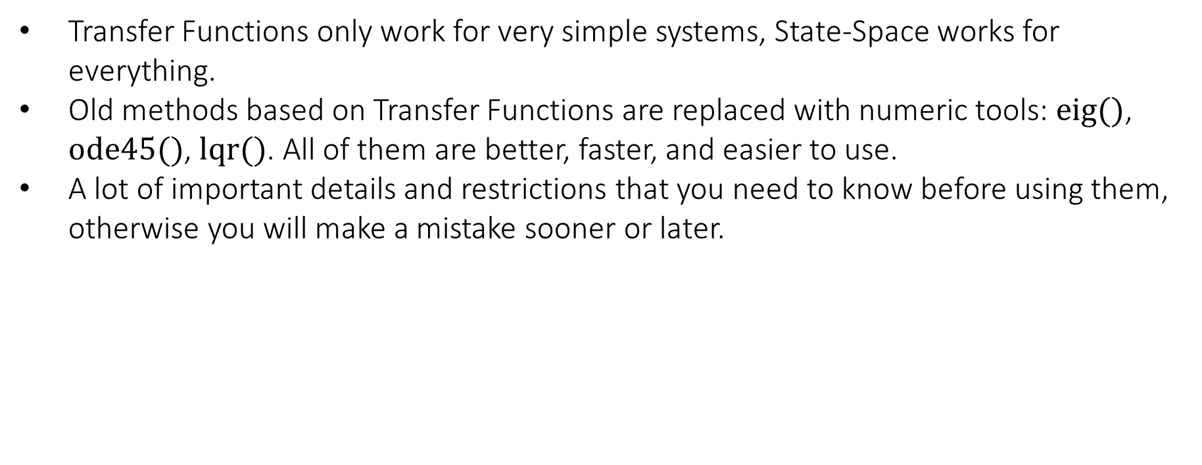
Reasons to Avoid Transfer Functions
Transfer Functions only work for very simple systems, State-Space works for everything.
Old methods based on Transfer Functions are replaced with numeric tools: $eig()$, $ode45()$, $lqr()$. All of them are better, faster, and easier to use.
A lot of important details and restrictions that you need to know before using them, otherwise you will make a mistake sooner or later.
Control Theory (Linear Control)
Slide 9

Slide 10
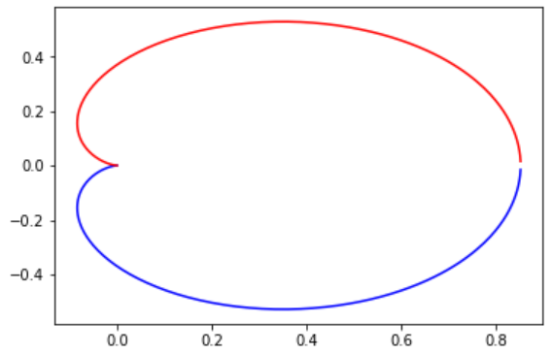
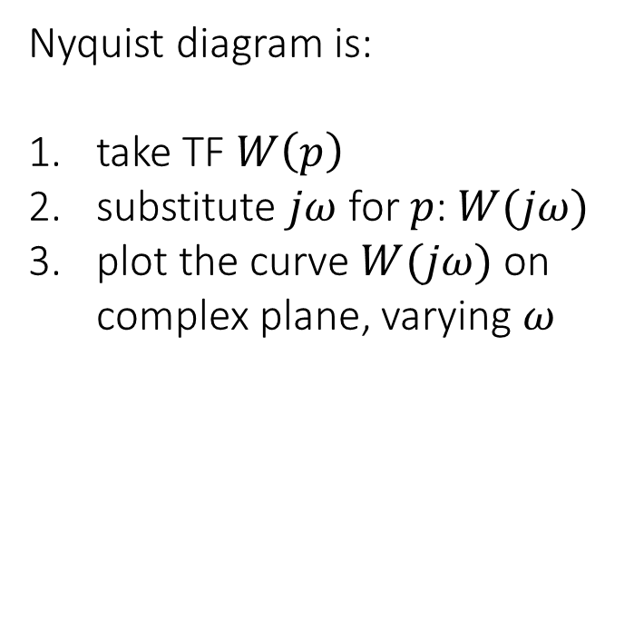
Nyquist Diagram
Nyquist diagram is:
take TF $W\left(p\right)$
substitute $jω$ for $p$: $W(jω)$
plot the curve $W(jω)$ on complex plane, varying $ω$
Control Theory (Linear Control)

Slide 11
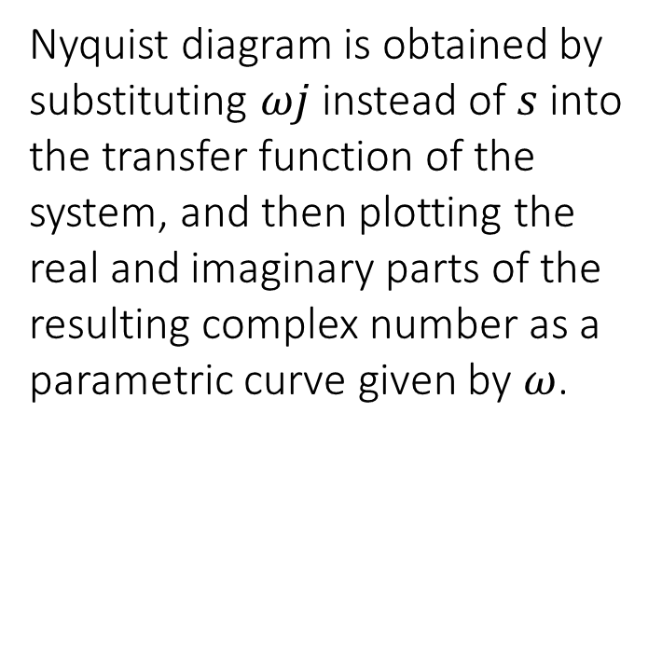
Nyquist Diagram and Bode Plot (1/3)
Nyquist diagram is obtained by substituting $ωj$ instead of $s$ into the transfer function of the system, and then plotting the real and imaginary parts of the resulting complex number as a parametric curve given by $ω$.
Control Theory (Linear Control)

Slide 12
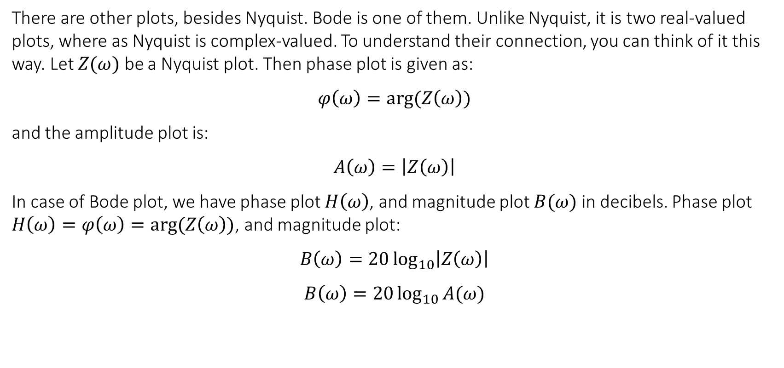
Nyquist Diagram and Bode Plot (2/3)
There are other plots, besides Nyquist. Bode is one of them. Unlike Nyquist, it is two real-valued plots, where as Nyquist is complex-valued. To understand their connection, you can think of it this way. Let $Z(ω)$ be a Nyquist plot. Then phase plot is given as:
$$φ\left(ω\right)=arg⁡(Z\left(ω\right))$$
and the amplitude plot is:
$$A\left(ω\right)=\left|Z\left(ω\right)\right|$$
In case of Bode plot, we have phase plot $H\left(ω\right)$, and magnitude plot $B(ω)$ in decibels. Phase plot $H\left(ω\right)=φ\left(ω\right)=arg⁡(Z\left(ω\right))$, and magnitude plot:
$$B\left(ω\right)=20\log_{10}\left|Z\left(ω\right)\right|$$
$$B\left(ω\right)=20\log_{10}{A(ω)}$$
Control Theory (Linear Control)

Slide 13
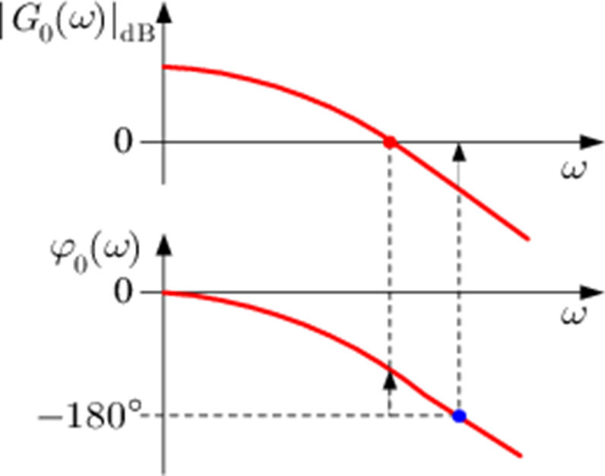
Nyquist Diagram and Bode Plot (3/3)
Control Theory (Linear Control)

Slide 14
The End
Do you have any questions?

